Slide 1

Session 2
Learning Outcomes, Syllabus Creation and Documentation
FAIR Training Material by Design
September 18-19, 2024
Jill Jaworski & Jessica Lindvall

Slide 2
What you can expect from this session
Time: 1min
Introductions from us and our instructor styles
Who we are and what we do
Our instructor styles and what you can expect from us
This session’s
Content - we’re focusing on chapters 2, 3, and 8 of the FAIR Training handbook
Learning Outcomes
How to participate in the activities
Reflections
Notes:
Setting Expectations

Slide 3
Topics and Themes to be Discussed in this Session
It is important to have a FAIR mindset in the planning stage
FAIR must not be ad hoc…
Think ahead to providing Learning Outcomes that can be FAIR
Think about metadata that can make your training more FAIR
Consider your training’s infrastructure and hosting needs
Integrating FAIR principles into your planning help sets the stage for making all subsequent steps within the Training Life Cycle more FAIR as well
Notes:
A brief introduction to this session’s context… expanding on “what is FAIR and why do we care?”

Slide 4
Learning Outcomes
By the end of this session, learners will be able to:
Describe pedagogical frameworks and methods that support Learning Outcome development (including Bloom’s Taxonomy and the Smartie Principles)
Create Learning Outcomes relevant to their own training
Understand how Nicholl’s Five Steps and the Training LIfe Cycle relate to FAIR
Describe how documentation pedagogically supports FAIR trainings
Describe methods for and means of documenting trainings documenting in a FAIR way

Slide 5
How to Participate and Session Reflections
Contribute your thoughts!
Ask questions as we go along if anything is unclear
Be curious! Both on the material and on each others experiences
Write down any “Aha’s” (things you come to think of) throughout the course
Code of Conduct
Be respectful, honest, inclusive, appreciative and open to learning from all present
Do not attack, demean, disrupt others or encourage such behaviours
Reflections
We will be building in reflections throughout as activities, but we will also be seeking feedback in survey form after the course so that we can continue to improve this training

Slide 6
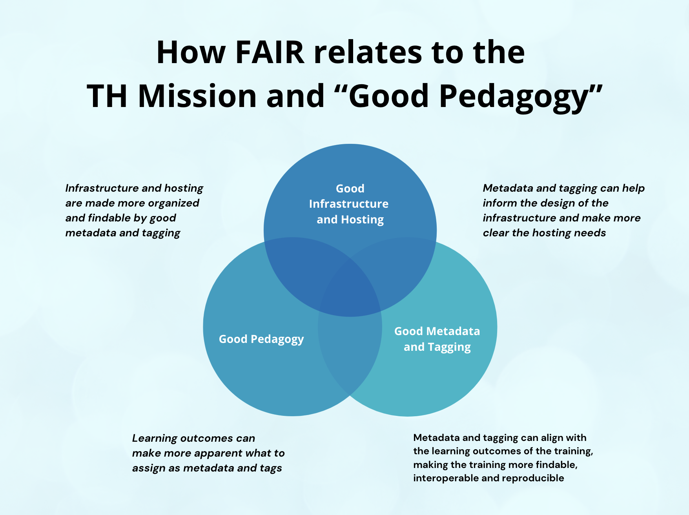
Notes:
Metadata and tagging can help inform the design of the infrastructure and make more clear the hosting needs
Learning outcomes can make more apparent what to assign as metadata and tags
Infrastructure and hosting are made more organized and findable by good metadata and tagging
Metadata and tagging can align with the learning outcomes of the training, making the training more findable, interoperable and reproducible
How infrastructure, metadata and pedagogy all inter-relate
Describe the interplay between each of these different levels and how they relate to FAIR, as well as how TESS and The Portal support these best practices
Describe FAIR Best Practices
TESS and Portal - gold standard in their design
By FAIRifying your training you are aligning your training with the requirements of the Portal / Tess
TESS is available open source, there are some adoptions across Europe - show resources to help them understand what the options are for them to host on
This is a (not so) subtle call to action to those interested in hosting their trainings on the TH Portal - these are our ideals for FAIR standards!

Slide 7
2.1 Learning Outcomes
Best Practices and their Relationship with FAIR
Notes:
Since we have identified that Learning Outcomes can help inform the metadata and tagging of your training when it resides within your infrastructure, let’s go over some best practices in how to create pedagogically sound Learning Outcomes!

Slide 8
What are Learning Outcomes?
Statements expressing which Knowledge, Skills, and Abilities (KSAs) learners will be able to demonstrate upon completion of a learning experience or a sequence of learning experiences
What will learners be able to do, at the end of a lesson that, the teacher (you) can evaluate?
Recommended Reading: https://irds.stanford.edu/sites/g/files/sbiybj10071/f/clo.pdf
Notes:
Do you remember what Learning Outcomes are? Can you define/describe them?

Slide 9
What are Learning Outcomes?
In short…
Statements expressing the KSAs that can be demonstrated upon LE completion
What learners will learn and the instructor can assess
https://irds.stanford.edu/assessment/assessment-overview/assessment-tools
Notes:
What impact can it have when you leave the learning outcomes to the end as an afterthought?

Slide 10
What are Learning Outcomes
and How do they relate to FAIR?
How we believe LOs most relate FAIR
We feel that LOs most relate to Interoperability and Reuse
Interoperability: by having clearly stated LOs (blooms level, active verb, target audience), other users of the material can align the materials to new contexts
Reuse: easily identified purpose for use
FAIR - LOs help to give the training context, across each of the dimensions of FAIR
Activity - Short discussion: How could LOs also relate to Findability and Accessibility?
5min: Four groups, one for each letter of FAIR
Debrief afterwards

Slide 11
How do you write *good* Learning Outcomes?
By incorporating…
SMARTIE Principles
Bloom’s Taxonomy

Slide 12
SMARTIE Learning Outcomes
S | pecific
M | easurable
A | chievable
R | elevant
T | ime-limited
I | nclusive
E | quitable
Notes:
Adhering to the SMARTIE principles ensures that learning outcomes aren’t just wishful thinking—they are actionable, measurable achievements. So what does it mean?
Specific: outcomes should be clear and specific. Instead of saying ‘understand biology’, aim for ‘describe the process of cellular respiration’.
Measurable: if you can’t measure the outcome, you can’t manage it. Use assessable verbs (which we’ll talk about next) like ‘analyze’, ‘create’, or ‘evaluate’ to make the outcomes quantifiable.
Achievable: set outcomes that are challenging but achievable. You want to stretch the students, demotivate them.
Relevant: the outcomes should align with broader teaching goals and be practically applicable to your students’ goals and career.
Time-limited: set a clear timeframe for when the outcomes can and should be achieved—by the end of the module, the session, or the course.
Inclusive: consider the diverse needs and backgrounds of your students—your outcomes should be accessible to everyone. We’ll talk about some ways to ensure this tomorrow.
Equitable: ensure your outcomes don’t favor one group over another—all students should have equal opportunities for success.

Slide 13
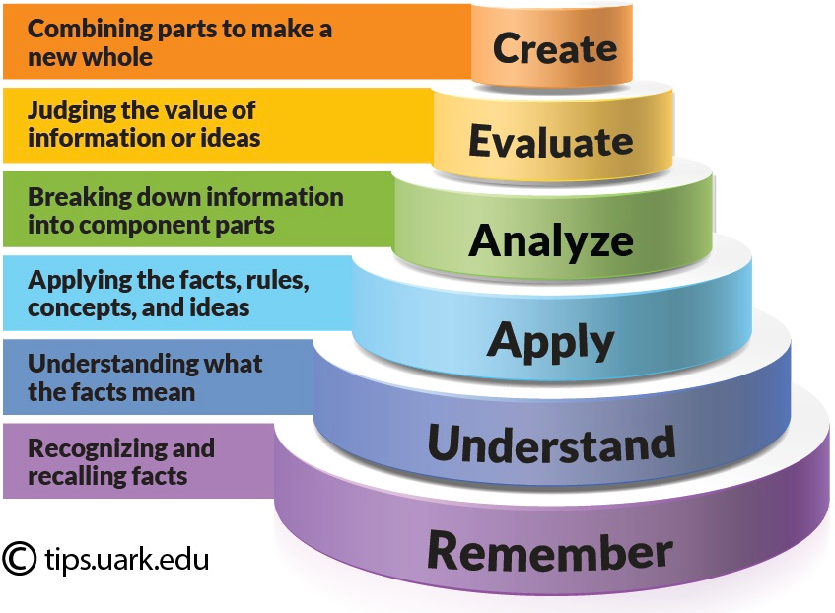
Bloom’s Taxonomy: a spectrum of cognitive complexity
abstract
concrete

Slide 14
Bloom’s taxonomy of verbs
Create | assemble, build, collect, combine, compile, compose, constitute, construct, design, develop, devise, formulate, generate, hypothesize, integrate, invent, make, manage, modify, organize, perform, plan, prepare, produce, propose, rearrange, reconstruct, reorganize, revise, rewrite, synthesize, write
Evaluate | advise, appraise, argue, assess, compare, conclude, consider, contrast, convince, correct, criticize, critique, decide, defend, determine, discriminate, grade, judge, justify, measure, rank, rate, recommend, review, score, select, standardize, support, test, validate
Analyze | arrange, break down, categorize, classify, compare, conclude, connect, contrast, deconstruct, deduce, detect, diagnose, diagram, differentiate, discriminate, distinguish, divide, examine, explain, identify, integrate, inventory, list, order, organize, relate, separate, structure
Apply | calculate, carry out, change, choose, classify, complete, compute, construct, demonstrate, dramatize, employ, examine, execute, experiment, generalize, illustrate, implement, infer, interpret, manipulate, modify, operate, organize, outline, perform, predict, solve, transfer, translate, use, verify
Understand | arrange, associate, categorize, clarify, classify, compare, conclude, contrast, defend, diagram, differentiate, discuss, distinguish, estimate, exemplify, explain, express, extend, extrapolate, generalize, give examples of, illustrate, infer, interpret, match, outline, paraphrase, predict, rephrase, represent, restate, summarize, transform, translate
Remember | cite, define, describe, identify, inventory, label, list, match, name, outline, quote, recall, recognize, report, reproduce, restate, retrieve, show, state, tell

Slide 15

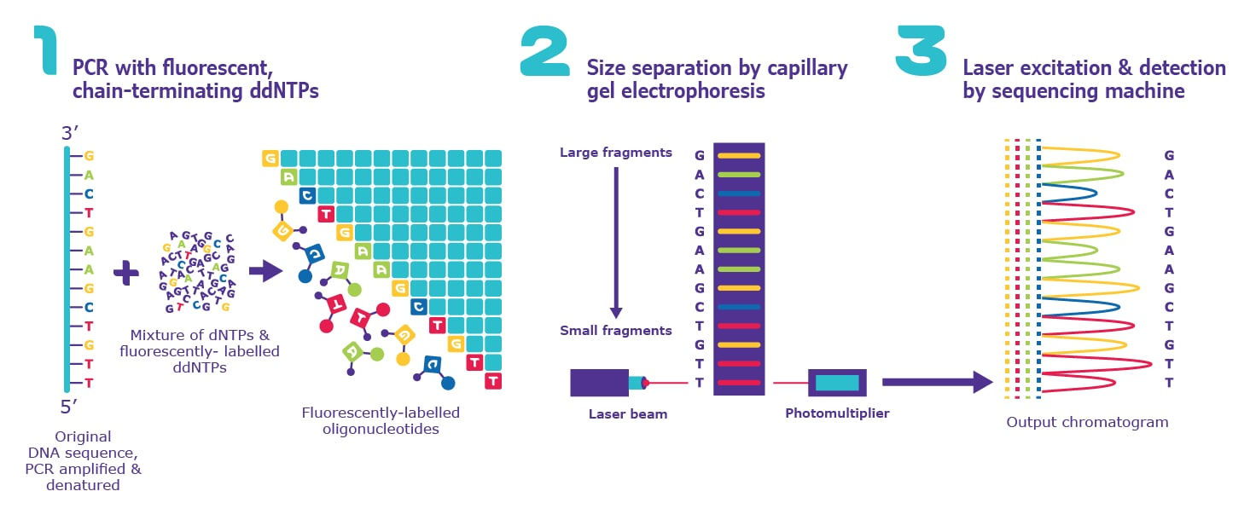
By the end of the course, learners will know DNA sequencing process
How to assess whether learners know the DNA sequencing process?
Image Source: https://www.sigmaaldrich.com/NO/en/technical-documents/protocol/genomics/sequencing/sanger-sequencing
Notes:
Anchor back to the Bloom’s accessible verbs (Both LOs and prerequisites) session 1

Slide 16
What do we mean by «knowing» the DNA Sequencing process?
They are able to describe it?
They are able to explain it?
They are able to apply it theoretically/practically in a project?
They are able to demonstrate it?
They are able to use it in a solving problem?
Notes:
various interpretations of “knowing”

Slide 17
What do we mean by «knowing» the DNA Sequencing process?
Are learners able to describe it?
Or explain it?
Or apply it?
Or demonstrate it?
Or use it in problem solving activities?
It would make more sense to ask:
What will learners be able to do to show they understand DNA sequencing?

Slide 18
Writing LOs with assessable verbs
Avoid verbs that are:
unassessable
unmeasurable
open to interpretation

Slide 19
Writing learning outcomes using ACTION verbs
Think about: what learners will be able to do by the end of a course that I (the instructor)
will be able to evaluate
Avoid verbs open to multiple interpretations
By the end of the course, learners will be able to …………………………………………………..………………
Use a verb that describes an observable action

Slide 20
Activity: Create Learning Outcomes
Reflect on your training
Define teaching/learning objectives (describe your goals and intentions as the instructor)
Write learning outcomes (think about what learners will be able to do by the end of this instruction; using Bloom’s taxonomy; actionable verbs)
Identify the target audience and prerequisites

Slide 21
2.2 Syllabus Creation
Best Practices and their Relationship with FAIR

Slide 22
How do you create a syllabus document?
Best Practices:
Incorporate your Learning Outcomes
include a section dedicated to them
Learning outcomes inform the decision making process of course and learning activity design
Incorporate your metadata
What is metadata?
Metadata will serve tags for your training to be found and organized amongst other trainings
The metadata that will be helpful to add / track to make the syllabus more FAIR

Slide 23
How do you create a syllabus document?
Your syllabus, at minimum, should include:
Basic information about the training (title, course code, meeting time and place, credits, etc.)
Contact information for instructors
Course description
Eligibility for participation
Key dates and times (course times; if applicable, assessment dates)
Expectations for completion of the course
Grading criteria (if applicable)

Slide 24
Your training will evolve as you develop it
And this is normal!
Your thinking will change as your continue to refine the training
Your training will likely continue to evolve even after you have delivered it
This is a highly iterative process
It can be helpful to think of this iterative process in two ways:
Nicholl’s Five Steps
The Training Life Cycle

Slide 25

Nicholl’s Five Steps
Phase 1
Learning outcomes (LOs)
Achievable LOs
Effective LEs
SMARTIE
Phase 5
Evaluation
Phase 2
Learning experiences (LEs)
Promotes LOs
Supports LEs
LEs aligned with LOs
Phase 4
Assessment
Phase 3
Content
Promotes LOs
Supports LEs
Nicholls G. Developing teaching and learning in higher education. London:Routledge;2002.
Notes:
Nicholl’s 5-step model is a straightforward approach to instructional design that’s based in cognitive psychology. The steps: analyze, design, develop, implement, and evaluate.
The process starts by analyzing what your students need to know and selecting learning outcomes according to SMARTIE principles, which we’ll talk about in just a minute. Then we design a course outline including learning experiences that help learners achieve LOs. We continue in the process by developing and implementing course materials, including assessments, then evaluating the effectiveness of our design. At each step in the process, you should loop back to the previous phases to make sure everything is aligned. If we’ve checked our progress after phase 5 and everything aligns, we’re ready. The LOs are pivotal; they support each successive phase and drive all decision-making.
Do any of you follow these steps, even informally? What process do you follow?

Slide 26
The Training Life Cycle
Design
Design
Develop
Develop
Deliver
Deliver
Evaluate
Identify
Evaluate
Identify
Audience analysis: Who are the professionals that will receive the training? What is their role? How does learning impact their day-to-day?
Process analysis: What are your organization’s workflows and processes? How does your chosen training method fall in line with these processes? Are there any bottlenecks or gaps the instructor can address through training?
Infrastructure analysis: Do you have a physical in-house space for conducting training? Is your digital infrastructure up to date for e-learning solutions?
You’ll need to work out scope, depth, training objectives, and more. Once established, you can use this as the basis for curriculum topics and subtopics, serving as the foundation for your training solution. Designing your course will also involve creating any relevant training templates or documents you may need for the course.
Developing instructional materials and exercises: You’ll need to develop the course materials and handouts based on the curriculum and templates designed in phase two. After finalization, it’s time to test this material through the pilot.
Conducting the pilot: The pilot is a way to test training effectiveness in a real-world setting. You can test your course with a small group of learners with one or multiple sessions. The aim here is to collect feedback on the course.
Revising materials: After piloting, you’ll need to revise materials, like presentations and job aids, based on the feedback you received. This can entail changing the course material. In some instances, it may also lead to changing the course curriculum to better suit learners during the implementation phase.
Scheduling the training: Before the training course starts, you’ll need to work with your in-house training team or training provider to create a detailed schedule for attendance. Some important factors to consider include workload and participant availability.
Registering participants: A registration system helps trainers analyze the success of a training course, monitor attendance, and ensure smooth communication between members. This could be through a physical sign-up sheet or part of a digital learning management system.
Conducting the training: Trainers will begin teaching the course according to the chosen method and materials. While conducting the classes, training instructors should aim to create an environment that’s conducive to learning. In smaller groups, they may also offer coaching or personalized attention.
Conducting surveys, interviews, and focus groups: You’ll need to establish a system for gathering feedback. Surveys, interviews, and focus groups can all provide relevant insights into the training solution’s impact.
Analyzing feedback and recommending changes: Once you’ve collected enough feedback, analyze it and identify any emerging trends. This will serve as the basis for further recommendations, updates, and improvements.
Updating material: Update material to reflect the feedback for future learning. This could include taking out irrelevant content or reformatting for better engagement.

Slide 27
Activity: How does the Training Life Cycle relate to FAIR?
Activity: Take two minutes to discuss with the person beside you
Debrief as a big group afterwards

Slide 28
2.3 Documentation
Best Practices and the Relationship with FAIR
Notes:
Describe the metadata

Slide 29
Why is documentation important to the FAIR process?
Activity: Take two minutes to discuss with the person beside you

Slide 30
Why is documentation important to the FAIR process?
Documentation is important because…
Helps to add context
Shows how the training has evolved and why
Helps others recreate, repurpose or borrow from the training
Helps to acknowledge author and instructor contributions
Acts as a form of version history and version control
Anything else?
* participants share their ideas with the bigger group*

Slide 31
How can we best document our
trainings to make them FAIR?
Activity: Take five minutes to discuss in groups of 3-4
Debrief as a big group afterwards

Slide 32
How can we best document our trainings to make them FAIR?
Data-level documentation includes information about specific data files like: • Data type • Structure of the data, e.g. questions, variables, concepts • Data processing procedures, … and so on (this list is not exhaustive) Project-level documentation describes: • When, how and why the data were generated and by whom • How the data were processed • What quality assurance measures have been used, … and so on (this list is not exhaustive)
Anything else we can think of?
* participants share their ideas with the bigger group*

Slide 33
How can we best document our trainings to make them FAIR?
Data-level documentation:
Documents or ReadMe files contextualizing data and data types
Data management plan
What else?
Project-level documentation:
Recordings
Syllabus
Instructor’s handbook
What else?

Slide 34
What are the differences between metadata and documentation?
Activity: Take two minutes to discuss with the person beside you

Slide 35
What are the differences between
metadata and documentation?
There will likely be some overlap, so take some time at the start of the project to decide on what information can and should be repeated
This can be very helpful for synchronizing your Learning Outcomes with your metadata
Can think of metadata as tagging system for your training to be found amongst other trainings, whereas documentation refers to the textual context that describes the training

Slide 36
References
The FAIR Guiding Principles for scientific data management and stewardship
Wilkinson, M. D., Dumontier, M., Aalbersberg, I. J., Appleton, G., Axton, M., Baak, A., ... & Mons, B. (2016). The FAIR Guiding Principles for scientific data management and stewardship. Scientific data, 3(1), 1-9.
Go FAIR
https://www.go-fair.org/
How To FAIR
https://howtofair.dk/

